Slide 1
CROWD FUNDING PROJECT ANALYSIS

Slide 2
What is crowd funding:
Crowdfunding is raising small amounts of money from a large number of people, typically online, to fund a specific project, business, or cause, bypassing traditional financial intermediaries like banks. Project creators present their idea on a platform (like Kickstarter, GoFundMe), set a funding goal and deadline, and supporters contribute, often receiving rewards, perks, equity, or simply supporting the cause. It's used for startups, creative projects, charities, and personal needs, leveraging social networks for broad reach.
How it works:
Initiation: An individual or group (the initiator) proposes a project on an online platform, setting a financial target and timeframe. Promotion: The campaign is shared through social media and networks to attract backers Contribution: Many individuals ("the crowd") pledge small amounts of money. Funding Model: If the goal is met (or sometimes even if not, depending on the model), funds are transferred, and backers receive their promised rewards or returns

Slide 3
Major Types:
1.Rewards : Backers get non-financial perks. 2.Donation : People give money to support a cause or individual without expecting a return. 3.Equity : Funders receive a small ownership stake (equity) in the company, becoming shareholders 4.Debt (Lending) : Backers lend money that the project owner promises to repay with interest.

Slide 4
Tools Used: Excel, Power BI, Tableau, and MY SQL.
Data Sets Used: Crowd Funding Projects,
Crowd Funding Category, Crowd Funding locations,
Crowd Funding creator.
Concepts Used: Data Cleaning, Data Modelling, Data Visualization.
And other concepts
Prepared by: Vangala Santhosh
Shraddha Abhang,
Vasa Naga Lakshmi Durgambika
Kunal Kakasaheb Korade, Satish Bhagwat jagtap, Aishwarya K.

Slide 5
Objective
The main objective of a crowdfunding project is to secure capital from a large number of individuals (the "crowd") via online platforms to fund a specific project, idea, or cause
Primary Objectives includes Validation of ideas, Creating a community & customer base, Marketing & publicity, accessing to capital without Debt/Equity loss, Product Testing and feedback.

Slide 6
Main areas to focus
Pre Launch planning
Compelling Storytelling & Transparency
High-Quality Visual Content
Reward Systems & Tiered Pricing
Effective Promotion & Communication
Post-Campaign Fulfilment & Closure
Strategic Platform Selection

Slide 7
Projects Overview - KPI’S
38%
80.38
140.31
3479.48M
Backers
Sucessful Projects
Average
Days
Amount Raised
Key Insight : “Although only 38% of crowdfunding projects succeed, successful campaigns generate significant funding and attract large backer communities, demonstrating that engagement and sustained campaign effort are key to crowdfunding success”.

Slide 8
Projects by Country
The Major Portion took by United states staking with 278.52 K and followed by Great Britian 34.07 K and Minor Portion took by LU 0.07 K and followed by JP 0.31 K
Key insights are followed by below
Crowdfunding adoption and maturity are significantly higher in the US compared to other regions
Crowdfunding activity is highly concentrated in a few countries, with the US leading by a large margin
Language, digital penetration, and platform availability strongly influence crowdfunding participation
Crowdfunding has limited penetration in several regions, indicating growth opportunities
There is strong potential for platform expansion and creator education in underrepresented regions

Slide 9
Projects by Outcome
Outcome : Successful – 143.91 trillions, Failed – 191.48 trillions, Live – 3.39T
Cancelled – 33.09 trillions, Suspended- 1.57 trillions, Purged- 0.19 trillions
Key Insights:
Most crowdfunding campaigns do not meet their goals, highlighting strong competition and planning challenges.
Careful goal setting, category selection, and marketing are critical to improve success probability
Poor preparation or changing circumstances often lead creators to cancel projects before completion.
Crowdfunding campaigns are time-bound and reach an outcome relatively fast.
Most failures are due to performance, not policy or compliance issues

Slide 10
Projects by Category
Top Category Tabletop games 15.62 K and bottom Taxidermy 0.01K
Key Insights are followed by below:
Crowdfunding is most popular in creative and entertainment-driven categories where community support is strong.
Strong fan bases and community-driven products significantly increase crowdfunding adoption.
Storytelling-based projects consistently attract creators due to their suitability for reward-based crowdfunding.
While popular, lifestyle categories face higher competition and require stronger differentiation to succeed.
Educational and children-focused categories remain underutilized and may represent niche growth opportunities.

Slide 11
Projects by Trend Analysis
The main objective to provide based on year, quarter and month.
Key Insights are followed by below:
Crowdfunding success is highest in early-year months, drops significantly during mid-year—especially July—and recovers toward the end of the year, highlighting strong seasonality in campaign performance
Crowdfunding success rates peak in Q1, decline through mid-year with the lowest performance in Q3, and recover moderately in Q4, highlighting strong seasonal impact on campaign outcomes
Crowdfunding success rates were strong in early years, declined during peak competition, and later recovered as creators and platforms matured—while the final year shows an anomaly likely due to incomplete project outcomes

Slide 12
Top 10 Successful Projects – KPI’s
This project took 1st place in terms of amount raised name Amount Raised by Pebble Time - Awesome Smartwatch with 20.34 Million.
This project took 1st place in terms of backers count is Yooka-Laylee - A 3D Platformer Rare 73.21 K
The top 10 successful crowdfunding projects account for a disproportionately large share of total funds raised, driven mainly by innovative physical products, strong brand trust, and compelling problem-solving narratives
Projects with the highest backer counts are typically community-driven, emotionally engaging, and highly shareable, proving that strong audience engagement is as critical as funding size in crowdfunding success

Slide 13
Overall Percentage of Successful Projects
These are the brief insights of projects by category and goal range, Chiptune category is highest in percentage, whereas 29.81 % under 0 – 1K goal range
Crowdfunding success rates vary widely by category, with niche and community-driven categories achieving significantly higher success compared to highly competitive or capital-intensive categories
Crowdfunding success rates decrease sharply as funding goals increase, with projects under $10K significantly outperforming high-goal campaigns, highlighting the importance of realistic goal setting.

Slide 14
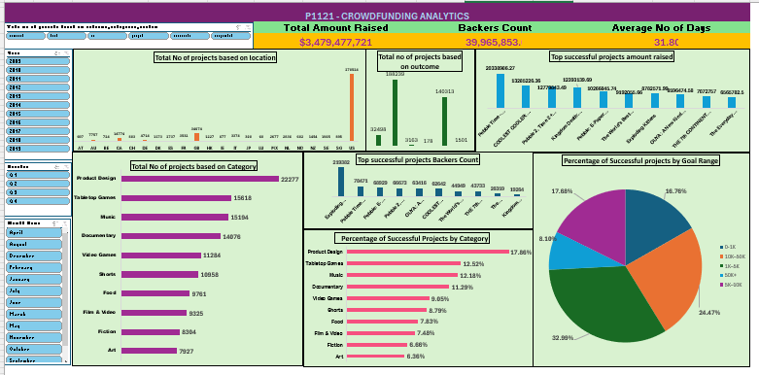
Excel Dashboard :

Slide 15
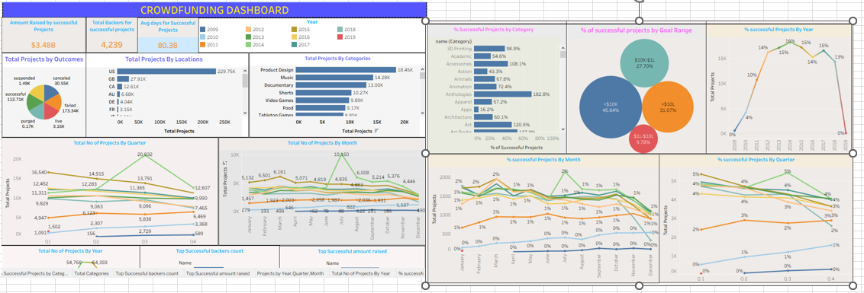
Tableau Dashboard :

Slide 16
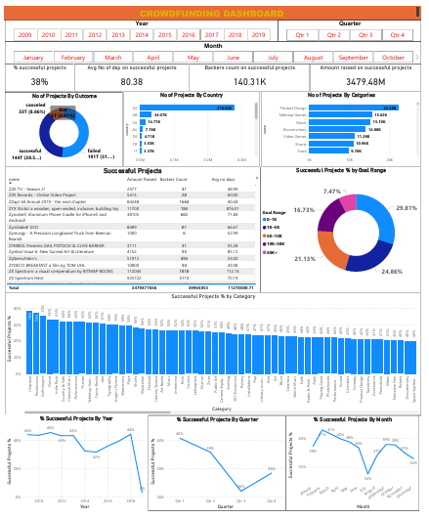
PowerBI Dashboard :

Slide 17
Challenges Faced
• Data Cleaning & Standardization – Handling missing values, inconsistent formats, and incorrect data types across multiple Excel sheets.
• Date & Calendar Table Creation – Converting epoch time and correctly building Financial Month and Financial Quarter without errors.
• Power BI Data Modeling & DAX – Establishing proper relationships and writing accurate measures like Success %, Total Projects, and Successful Projects.
• Importing Data into SQL – Understanding file paths, secure settings, and correctly loading cleaned Excel data into MySQL Workbench.

Slide 18
Conclusion
This project delivers a clear, data-driven understanding of Kickstarter crowdfunding performance by analyzing how projects are created, funded, and successfully completed across different categories, locations, and time periods. The study highlights how goal amount, number of backers, project duration, and category choice significantly influence campaign success, while interactive dashboards help visualize funding trends and success patterns effectively. Overall, the analysis demonstrates how data analytics can support better decision-making for creators, helping them set realistic goals, attract more backers, and design stronger campaigns for successful crowdfunding outcomes on Kickstarter.

Slide 19
THANK YOU

